Slide 1
WHY ESG PRINCIples MATTER TO YOUR STARTUP
Kristiana Fox
Phoenix Startup Week
April 26, 2022

Slide 2
WHAT IS ESG?

Slide 3
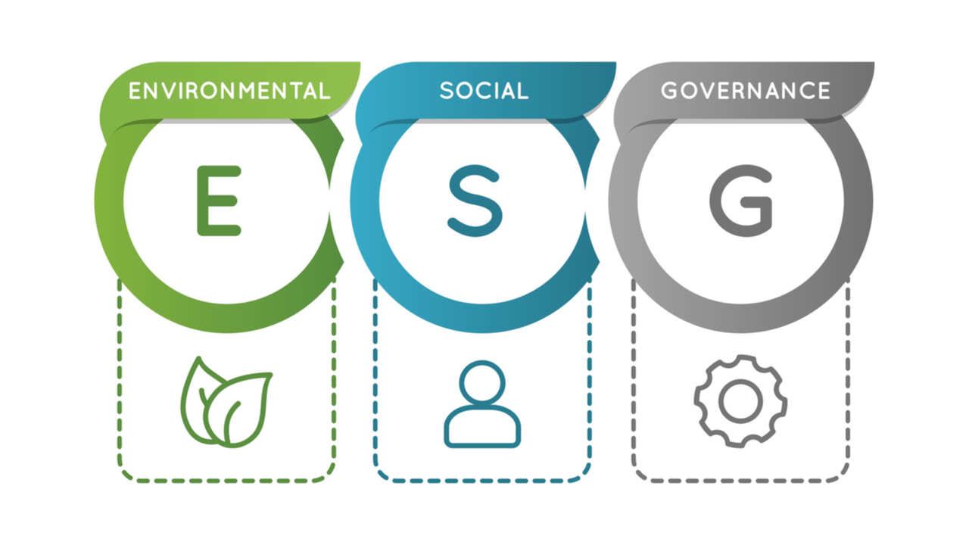
Notes:
WHAT is ESG= Environmental, Social and Governance standards for a company’s operations

Slide 4
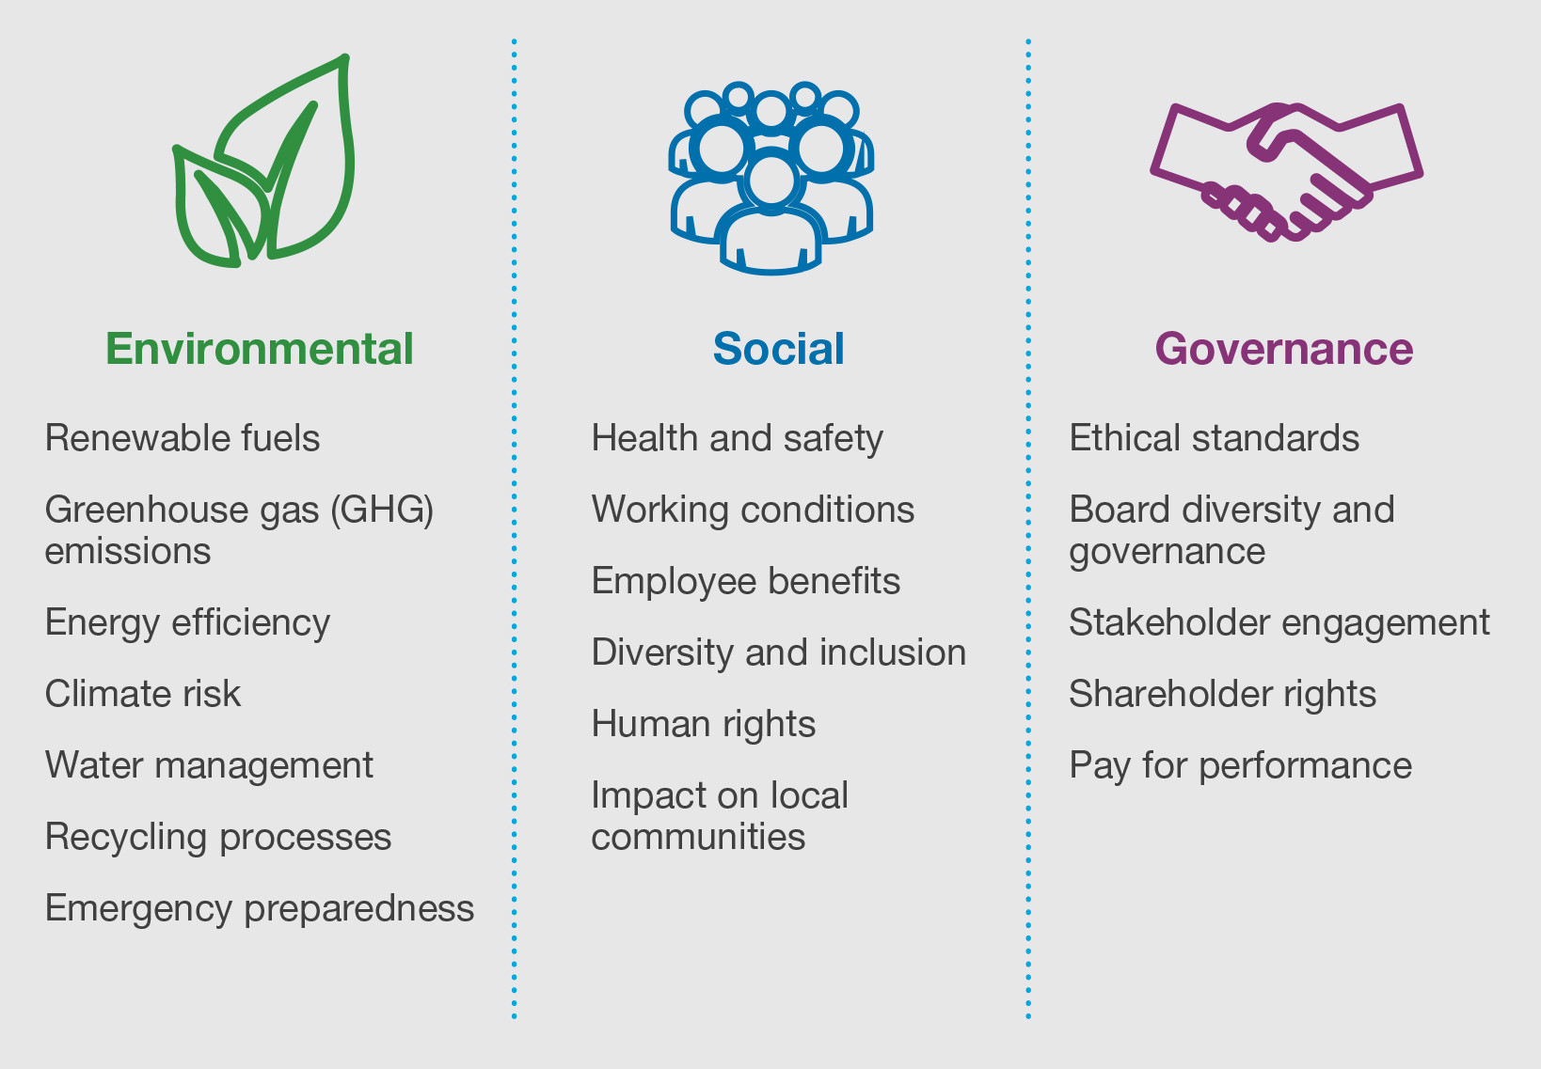
Notes:
Environmental= Environmental criteria consider how a company performs as a steward of nature
Social= social criteria examine how it manages relationship with employees, suppliers, customers, and the community where it operates.
Governance= governance deals with a company’s leadership, executive pay audits, internal controls and shareholder rights. This also includes a company’s culture, structure, polices and procedures

Slide 5
HOW DID ESG EVOLVE?

Slide 6
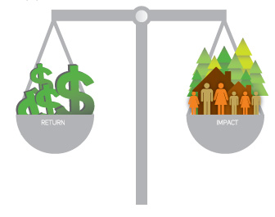
Notes:
Milton Friedman’s definition of capitalism needs to be revised, shift from shareholder capitalism to stakeholder capitalism. Enacting Purpose Initiative, a return to a more balanced capitalism or ‘Conscious Capitalism.’

Slide 7
Related terms

Slide 8
CORPORATE SOCIAL RESPONSIBILITY

Slide 9
Corporate Social Responsibility (CSR) is a business model where a company’s activities enhance the world around them.

Slide 10
Sustainability

Slide 11
Sustainability refers to a company’s relationship to the environment by creating long-term value.
Notes:
ESG extends that relationship to social responsibility and corruption. ESG is an external investment framework, or a form of metrics that helps companies communicate their initiatives and investors assess the company’s performance and risk. Sustainability is an internal framework that guides the organization’s capital investments. Sustainability is the motivation, ESG is the outcome.

Slide 13
Net Zero

Slide 14
Net Zero refers to reducing the human-caused emissions of carbon dioxide (CO2) to 45 by 2030, and reaching net zero by 2050.

Slide 16
United nations (Un) sustainable Development Goals (SDG)

Slide 18
Certified B Corporation/ Benefit Corporation

Slide 19
B COrporations
Certified B Corporations are businesses that meet the highest standards of verified social and environmental performance, public transparency, and legal accountability to balance purpose and profit.
Notes:
Examples of companies: Ben & Jerry’s, Patagonia, the Honest Company

Slide 20
BENEFIT CORPORATION:
A benefit corporation is a traditional corporation with modified obligations committing it to higher standards of purpose, accountability and transparency. Benefit corporations commit to creating public benefit and sustainable value in addition to generating profit.
Notes:
The difference between B Corporation and Benefit Corporation is that B Corporation is a third- party certification that requires that companies to become a Benefit Corporation (or equivalent hybrid structure), legal jargon is also given for other business structures to add to their operating agreement without changing their legal status (like an LLC).

Slide 21
IMPACT INVESTING & SOCIALly RESPONSIBLE INVESTING (SRI)

Slide 22
Investments made into companies, organizations, and funds with the intention to generate a measurable, beneficial social or environmental impact alongside a financial return.

Slide 23
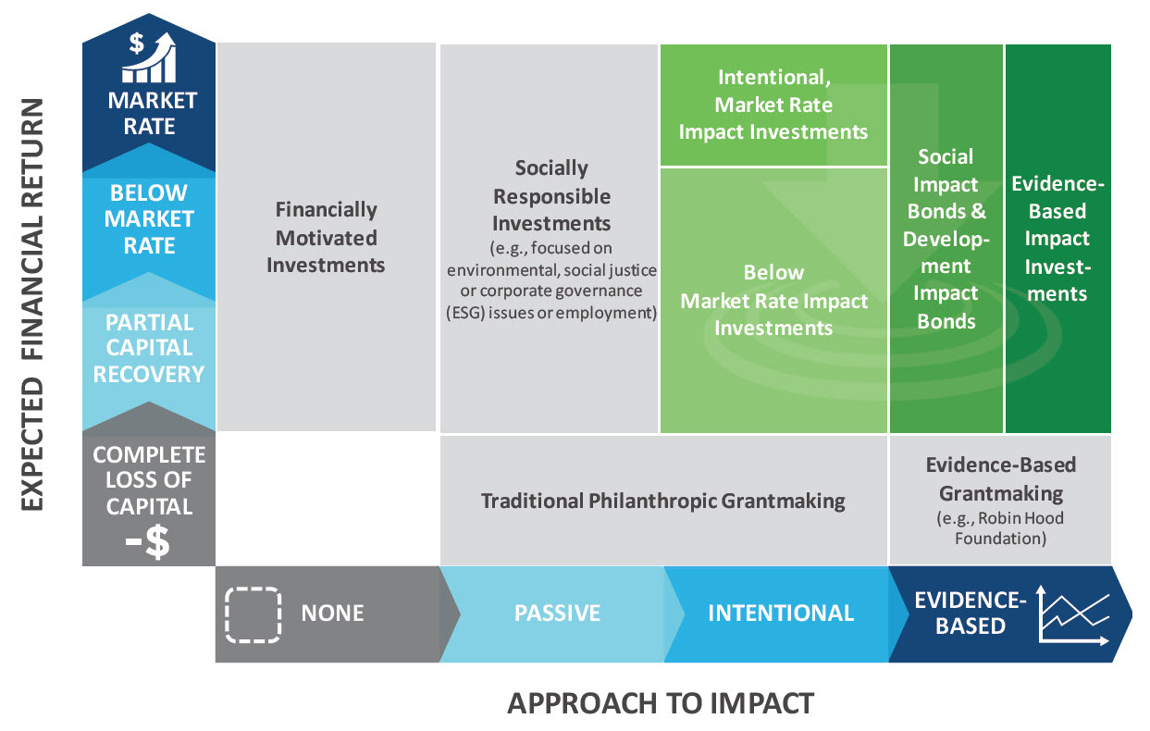

Slide 24
WAYS WE MEASURE ESG

Slide 25
Notes:
Global Reporting Initiative (GRI): is a framework that helps companies disclose both the positive and negative impact their business has on the environment, the economy, and society. 83% of all ESG frameworks.
Sustainability Accounting Standards Board (SASB) area set of standards that help companies collect and share ESG data that affect the firm’s business decisions and explain the financial impact of sustainability.
The Task Force on Climate Related Financial Disclosures (TCFD) is a framework that provides principles- based recommendations for managing and reporting focused primarily on climate risks.
Carbon Disclosure Project (CDP) is an international non-profit focuses on creating standards that companies can use to disclose information pertaining to GHG emissions, water use and foresty. This set of standards helps disclose decarbonization and environmental protection efforts.

Slide 26
BENEFITS OF ESG

Slide 27
1. Attracting Investors
2. Competitive Edge
3. Improved Reputation
4. Recruiting and Retaining Employees
Notes:
Failing to anticipate and address ESG factors in the planning and execution of the business can materially and adversely impact the bottom line. Investors are integrating ESG factors into investment decisions (risk mitigation)- along with financial performance and market benchmarks.
ESG can offer a competitive advantage and show that they can perform better across several financial metrics, they often avoid short- term solutions and invest in cost- effective sustainable innovations that deliver long- term returns. Consumers are increasingly concerned with company values and are loyal to brands that align with their own beliefs and are quick to dismiss brands deemed harmful to society or the environment.
A focus on ESG could help build trust with consumers and distinguish it from its competitors. This can improve a start-up’s reputation, but also lead to positive press.
Having a strong ESG focus can help a start-up to attract top talent. 40% quote…. Having a company mission that aligns with employee’s personal values can foster stronger employee engagement, which can in turn, reduce employee turnover and boost productivity, all of which feed into higher profitability.

Slide 28
“69% of startups agreed that ESG would result in more sales”…
Notes:
and 91% agreed it would assist in attracting and retaining the best talent for their companies.”

Slide 29
“Nearly 40% of millennials in the US have chosen a job because of company sustainability”…
Notes:
and more than 70% would take a pay cut to work for a company with a strong environmental mission.”

Slide 30
PROBLEMS WITH ESG

Slide 31
1. Ethics might become more important than performance.
2. You may be leaving a lot of investments on the table.
3. Many claim to be socially responsible, but they aren’t (greenwashing).
4. The definition of socially responsible investing is highly subjective (no set of standards or regulations).

Slide 33
PURPOSE AND WHY

Slide 34
“70% of employees now demand purposeful work.”

Slide 36
Example of a company’s Why
Greyston Bakery’s Purpose is not to hire people to bake brownies: it’s to bake brownies to hire people.
Their WHY is about extending opportunities to individuals who might have trouble getting jobs (formerly incarcerated or addicted individuals, for instance.)
Their WHAT is their Community Program and Open Hiring policy are designed around HOW to fulfill their purpose.

Slide 38
WAYS TO SUCCESSFUL INCORPORATE ESG

Slide 39
ESG
Purpose Driven

Slide 40
Leadership
Strategy
Culture
Notes:
Leadership, Strategy and Culture should revolve around your Purpose.
Do not think that profit-led businesses can add in a little CSR, chuck in a few environmental policies and gain all the advantages of a true purpose-driven business. No, consumers very easily see through this ‘greenwash’. A true purpose-driven business that generates the growth and profitability we have discussed here will have fundamentally changed their business DNA and will look, smell and act in a completely different way to traditional businesses.

Slide 41
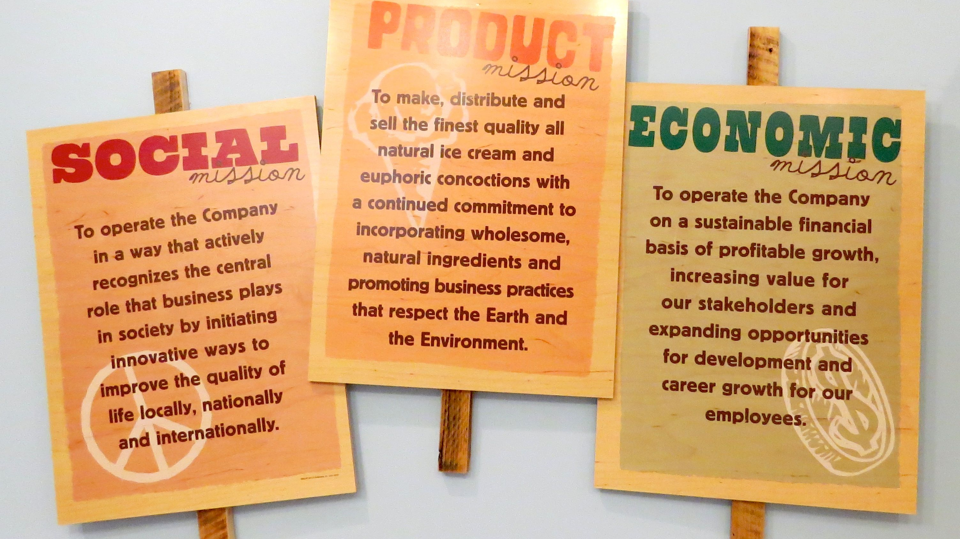

Slide 42
1. It all starts with mission.
2. ESG is a long game that requires adjusted timescales for impact.
3. ESG must be market- based.
Notes:
A company’s mission reflects corporate values and leadership buy-in to ESG goals.
Doing ESG well requires time, but is not a slow process. You can revise your purpose, conduct life- cycle analyses and hold every team accountable to the environmental and social considerations of your shared mission.
You need to identify quantifiable and measurable outputs, find market-based solutions for social impact that will facilitate scalability.

Slide 43
STEPS TO INCORPORATE ESG

Slide 44
1 Identify relevant ESG factors for your company and industry.
2. Develop ESG measurement and recording.
3. Consider a B Corporation Certification.
4. Integrate ESG into governance and investment documents.
Notes:
1. Focus on ESG factors that apply to your business. Map the ecosystem of stakeholders tied to your company, this includes your customers, employees, suppliers, regulators, shareholders and public. The Sustainable Accounting Standards Boards (SASB) Materiality Map is a tool that identifies relevant ESG factors for a variety of industries.
2. Decide which ESG framework you are going to use- some examples are SASB and GRI (Global Reporting Initiative is another one) which focus on sustainability reporting.
3. B Corp certified is a certified and licensing agreement with a self- audit that provides trust and accountability.
4. Embed social and environmental goals into governing documents, make it part of bonuses and promotions. Consider adding people to your board with one or members who support a social or environmental mission.

Slide 45
ESG and inVESTORS

Slide 46
“2/3 of investors see ESG criteria as core to their decisions over the next 3 years.”

Slide 47
THE FUTURE OF ESG

Slide 48
“60% of startups are already applying ESG strategies in their company structures.”

Slide 50
Contact information
Kristiana Fox, Founder/CEO
Think Outside the Box
www.thinkoutsidetheboxllc.com
Kristiana.fox@thinkoutsidetheboxllc.com

